Slide 1
Solve the riddle.
Am I a part of Great Britain?
The answer to that question is yes.
My capital is Edinburgh
And I have a monster in Loch Ness.
The answer is: SCOTLAND
Fly through the beautiful nature in Scotland.

Slide 2


Scotland
CULTURE SPOT

Slide 3


Slide 4
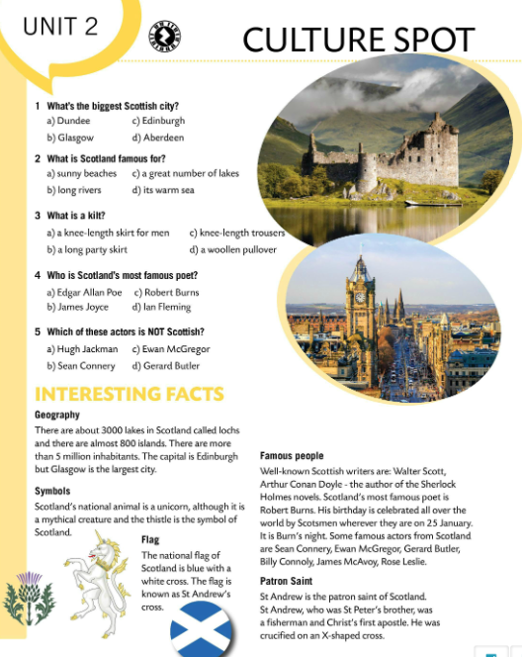
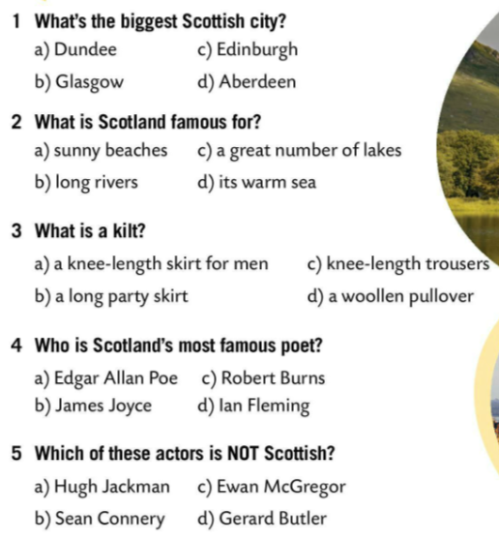
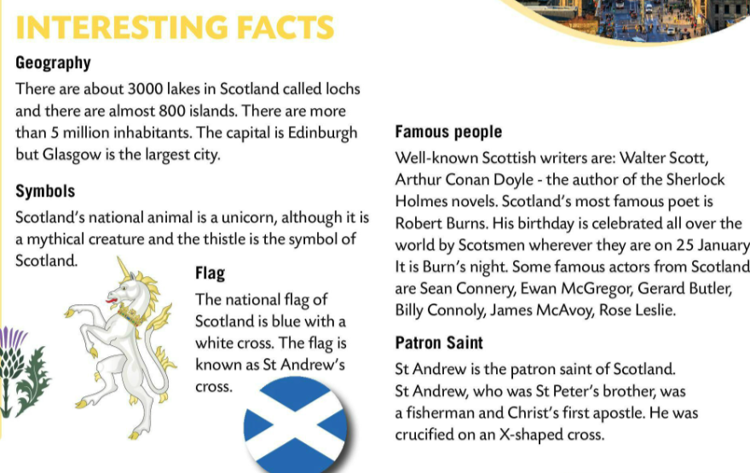
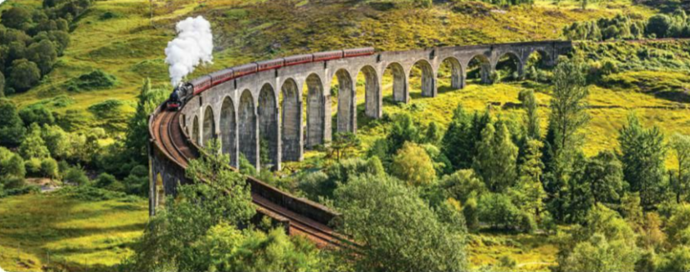
Do the quiz and check your answers in the text.
Read the text.
Let’s check!
Write five sentences about Scotland.

Slide 5
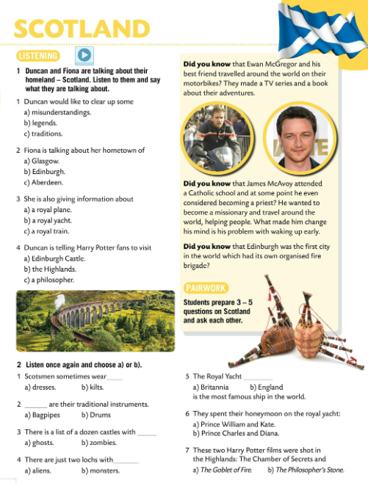
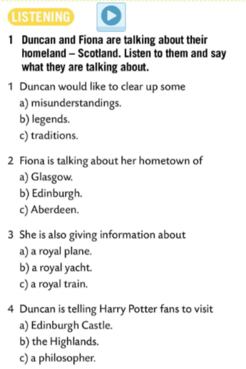
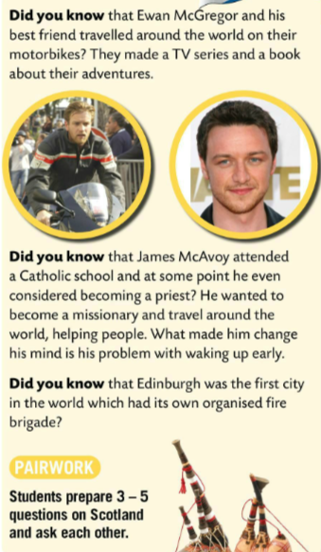
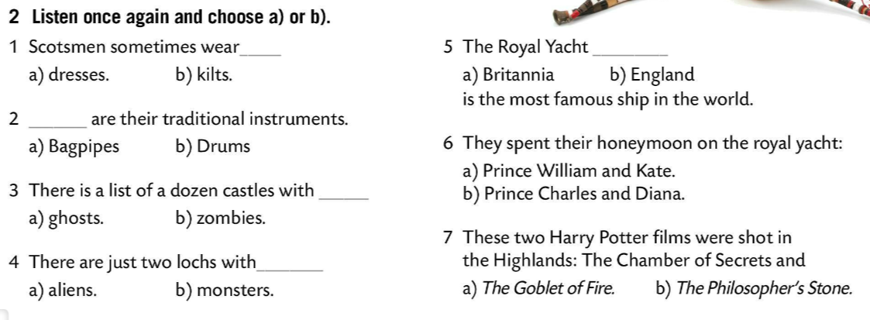

Read the text in pairs. Prepare 3-5 questions on Scotland and ask each other.
Duncan and Fiona are talking about their homeland – Scotland. Listen to them and say what they are talking about.
Check.
Listen again and complete the sentences.
Check.

Slide 6

Play this quiz and see how much you know about Scotland. https://wordwall.net/play/848/472/433
Make a poster. Include the most important information. You can add drawings and make the poster colourful. Enjoy! ☺

